Slide 1
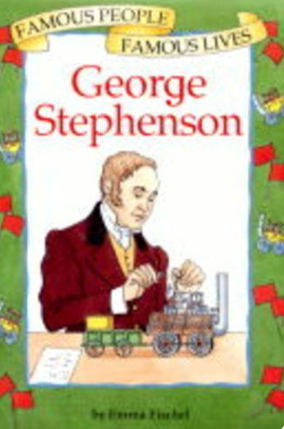
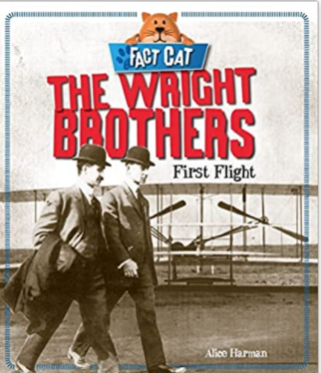
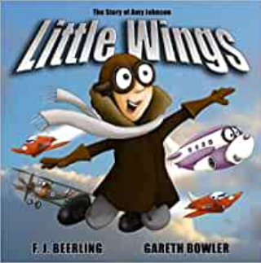
Great Inventions : Transport Knowledge Mat
Subject Specific Vocabulary |  | Interesting Books | Sticky Knowledge about Transport History
timeline | A tool which helps us organise information in chronological order | Important image to understand by the end of the Celebrations unit:
inventor | .A person who invents. Who has new ideas and makes something new which is helpful to others |  | One of the first trains was The Rocket, invented by Robert Stephenson in 1829. It was built and tested in the UK.
aviation | Flying using an aircraft
 | Also known as your backbone, your spine is a strong, flexible column of ring-like bones that runs from your skull to your pelvis. |  | The first motorised and controlled flight was in 1903 by two brothers, Orville and Wilbert Wright
cockpit | The area of the plane where the pilot sits. Inside the cockpit are all the controls for the aircraft
fuselage | The body of the aircraft | Important image to understand by the end of the Celebrations unit: | The first mass produced car was the Model T Ford in 1908 by Henry Ford in the United States of America
locomotive | An engine that moves by its own power
Rainhill Trials | A competition which was held to decide which mode of transport should be used on the Liverpool and Manchester Railway |  | In 1930 Amy Johnson became the first woman to fly solo from the UK to Australia
eyewitness account | An account of what happened from someone who was there at the time |  | In 1969, Neil Armstrong, Buzz Aldrin and Michael Collins were the first men to reach the Moon and Neil Armstrong was the first man to walk on the Moon
evidence | Photographs, objects, newspaper entries, diaries, telling us about what it was like in the past

