Slide 1
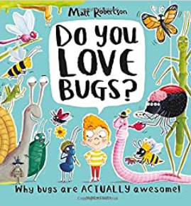
Understanding the World : The Natural World
Selection of linked objectives and ideas for supporting child development |  | Early Learning Goals | Useful Books
Explore the natural world around them Describe what they see, hear and feel whilst outside | Provide frequent opportunities for outdoor play and exploration. Encourage sensory engaegement with the natural world – touching, smelling, hearing different elements. Create opportunities to discuss how we take care for the natural world – provide opportunities to grow and nuture Encourage positive interactions with the natural environment, offering children chances to take supported risks Name and describe common plants and animals they may find | Explore the natural world around them, making observations and drawing pictures of animals and plants
Recognise some environments that are different to the one they live | Teach children about a range of contrasting environments within the local and national region Model the vocabulary needed to name specific features of the natural world Share non fiction texts about contrasting environments | Know some similarities and differences between the natural world around them and contrasting environments, drawing on their experiences and what has been read in class
 |  | Understand some important processes and changes in the natural world around them, including the seasons and changing states of matter
Understand the effect of changing seasons on the natural world around them | Guide understanding by drawing attention to the weather and seasonal features Provide opportunities for children to note and record the weather. Select texts to share about the changing seasons. Throughout the year take children outside to observe the world and encourage children to observe how animals behave differently as the seasons change

