Slide 1
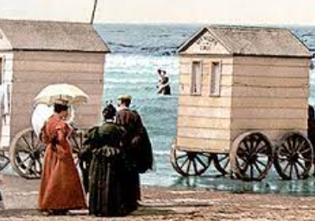
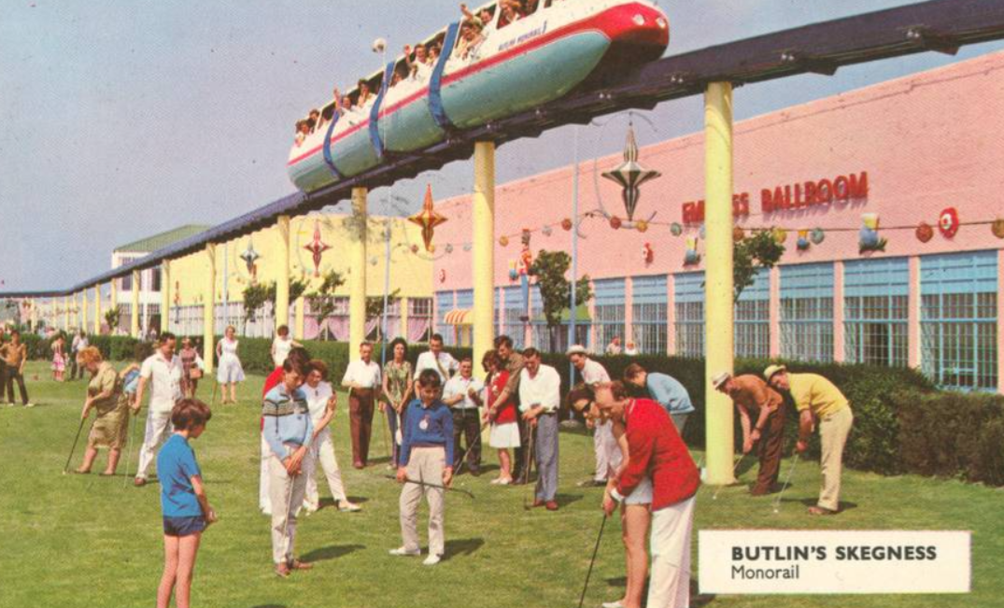

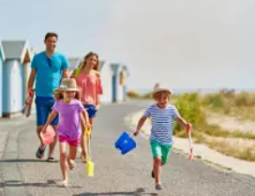
Holidays in the Past: Knowledge Mat
Subject Specific Vocabulary |  |  | Sticky Knowledge about Holidays in the Past
promenade | An area behind the beach but in-front of the hotels and shops where people would go for a pleasant walk. | Important image to understand by the end of the Celebrations unit:
pier | A platform sticking out into the sea where boats could moor. In Victorian times these piers were also home to lots of games and shops. |  | In 1900, Victorian holidaymakers enjoyed travelling to the UK seaside towns. They often travelled by steam train.
Punch and Judy show | A children’s puppet show. Punch and his wife, Judy are always fighting. Often a crocodile also appears. |  | Victorian holidays were often shorter than our holidays today, anywhere from 1 day to 1 week. Today people tend to go on holiday for longer, sometimes for 2 weeks at a time.
bathing machine | A Victorian dressing room on wheels where women could change into their bathing costumes. The machines were wheeled in and out of the sea.
 |  |  | In 1900, Victorian children liked to paddle in the sea, make sandcastles, watch the Punch and Judy show, ride donkeys and walk along the pier and promenade.
Victorian | People living in the Victorian period, 1837 to 1901 when Victoria was the Queen. | Important image to understand by the end of the Celebrations unit: | In 1900, Victorians liked to paddle in the sea, make sandcastles, watch the Punch and Judy show, ride donkeys and walk along the pier and promenande...
parasol | An object like an umbrella which protected people from the sun. |  | In 1950’s holiday camps such as Butlins and Pontins were popular. There were many holiday camps in the UK seaside towns. Holiday camps had lots of organized activities and some camps had indoor heated swimming pools. People travelled there by car or bus.
foreign holiday | A holiday taken away from the UK. People would travel by car, train, ferry or aeroplane. |  | Roald Amundsen was the first man to reach the South Pole in 1911, beating Captain Robert Scott by 16 days.
holiday camp | A place which provides a place to live on holiday for large numbers of people. In the 1950’s places such as Butlins and Pontins provided many people with a place to stay on holiday. The camps provided lots of organised activities to join in with. |  | Today, people go on holiday to the seaside but also to other places all over the UK. People are also able to go abroad on holiday and they travel there by ferry, train, car or aeroplane. Today, when we are on holiday, there are a huge number of activities from swimming pools, watersports, theme parks and museums to visit. People also enjoy eating food from different countries
hotel | A place where you can stay on holiday. You pay for your room and your food.

