Slide 1


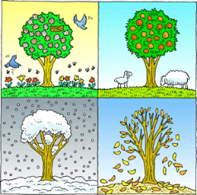

Seasonal Change Knowledge Mat
Subject Specific Vocabulary |  | Interesting Book | Sticky Knowledge about seasonal change
Autumn | The time of year between September and November. Many leaves fall off the trees.
Spring | The time of year between March and May. There is usually lots of signs of new growth in Spring.
 |  |  | In the UK we have four seasons: spring, summer, autumn and winter. Summer is the hottest season and winter the coldest.
Summer | The hottest season in the UK. It happens between June and August. The longest day is June 21st.
 |  |  | Changes in the weather with each season affects animals and plants. We notice the different seasons by looking at the changes to plants and animals.
Winter | The coldest season in the UK. We can have snow in this season. It occurs between December and February.
Fall | The name given to the Autumn season by Americans. It is because so many leaves fall off the trees.
 |  |  | Some animals (bats, hedgehogs and dormice) hibernate in the winter to shelter from the cold weather.
weather | Weather is what the sky and the air outside are like, such as cold and cloudy.
temperature | It is measurement of hot or cold that can be measured using a thermometer.
 |  |  | When we have our summer it is winter in the southern hemisphere. When we have our winter Australia has its summer.
thermometer | This is the instrument that measures the temperature.
weather symbol | These are signs used to help us understand more about our daily weather. |  | Weather can be different in different parts of the UK. It tends to be cooler and wetter in parts of Northern England and Scotland. The west of the UK tends to receive more rainfall than the east of the UK.
deciduous | Deciduous trees are trees that shed their leaves once a year, usually during the season of autumn.
coniferous | Most conifers are evergreens, or trees that keep their leaves year-round. |  | Seasons change throughout the year because of the way the Earth travels around the Sun.

