Slide 1
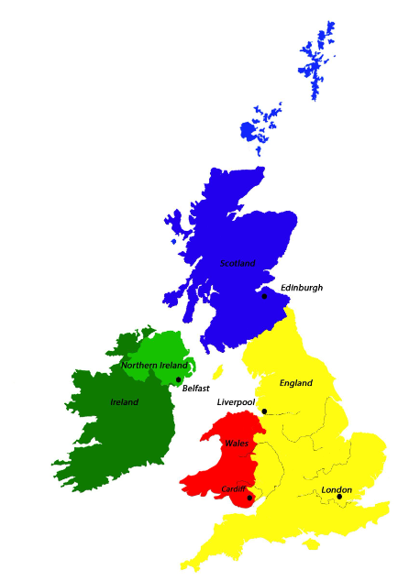
Food Journeys Knowledge Mat
Subject Specific Vocabulary |  | Map of UK | Sticky Knowledge about local food production
fresh food | A food that has not been altered | Important image to understand by the end of the Celebrations unit:
processed food | A food or ingredient that has been altered in some way eg by freezing, canning, baking, mixing with other ingredients. This is performed in a factory. |  | I know that I come to school in Bibury t, where there are few shops. My nearest town is Cirencester where there are lots of shops.
high street | The main street in a village, town or city which usually contains a mixture of shops where food can be bought
 | Also known as your backbone, your spine is a strong, flexible column of ring-like bones that runs from your skull to your pelvis. |  | I know that some of our food is produced in England and the UK but other foods need hotter and wetter climates to grow.
warehouse | Food products are stored in a warehouse before being taken to shops
factory | Food produce can be processed in a factory by baking, canning, freezing or mixing with other ingredients | Important image to understand by the end of the Celebrations unit: | I know that milk comes from cows and can discuss its journey from farm to supermarket.
frozen food | Frozen food is preserved by a freezing process and stored in a freezer before cooking.
 |  |  | I can name the 4 countries of the UK: England, Scotland, Wales and Northern Ireland.
Food producers or farmers | People who produce our food. They may plant crops and/ or raise animals to do this. The food they sell is called produce.
Food producers or farmers | People who produce our food. They may plant crops and/ or raise animals to do this. The food they sell is called produce. |  | I can name the capital cities of the UK: ENGLAND- London SCOTLAND- Edinburgh WALES- Cardiff NORTHERN IRELAND- Belfast
supermarket | A shop which sells lots of different sorts of food and goods. Fresh, frozen, dry and tinned produce are sold here. Food is brought to supermarkets by lorry, ship or by air.

