Slide 1
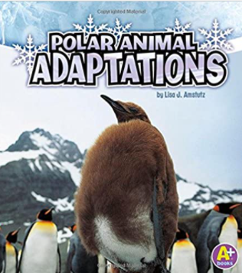
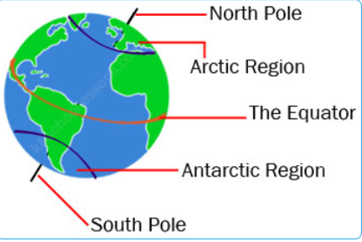
Polar Adventures Knowledge Mat
Subject Specific Vocabulary |  | Interesting Books | Sticky Knowledge about Polar Adventures
Arctic | The Arctic is the area around the northern most part of the Earth
Antarctic | The Antarctic is the area around the southern most part of the Earth |  | Carnivores are animals which only eat meat eg polar bears and wolves
carnivore | An animal that eats mostly meat. Examples include, spiders, frogs, owls, polar bears, seals, whales and wolves.
 | Also known as your backbone, your spine is a strong, flexible column of ring-like bones that runs from your skull to your pelvis. |  | Herbivores are animals which only eat plants eg reindeer
herbivore | An animal that eats only plants. Examples include butterflies, snails, reindeer, cows, deer | Where are the polar habitats ? | Omnivores are animals which eat both meat and plants eg bears and humans
omnivore | An animal that eats both meat and plants. Examples include bears, dolphins, hedgehogs and humans.
 |  |  | A mammal is an animal which gives birth to live young which drink milk
habitat | The place where you normally find an animal or plant living. |  | A mammal is an animal which gives birth to live young which drink milk
 |  |  | A bird is an animal which has wings, can usually fly and has feathers and a beak.
adaption | How animals and plants change to ensure that they can live in their habitat
 |  |  | A fish is an animal which lives in the water and has gills to allow it to breathe
waterproof | A material which does not let water through.
 |  |  | To live in a polar habitat, animals are adapted to for cold conditions. Some have white fur, some have thick fur and small ears, some have blubber. Some have wide feet .
insulated | A material which traps air near to the body to keep it warm.
flexible | A material that bends easily without breaking
 |  |  | To survive in the polar environment, humans must wear clothes which are waterproof and insulated.

