Slide 1
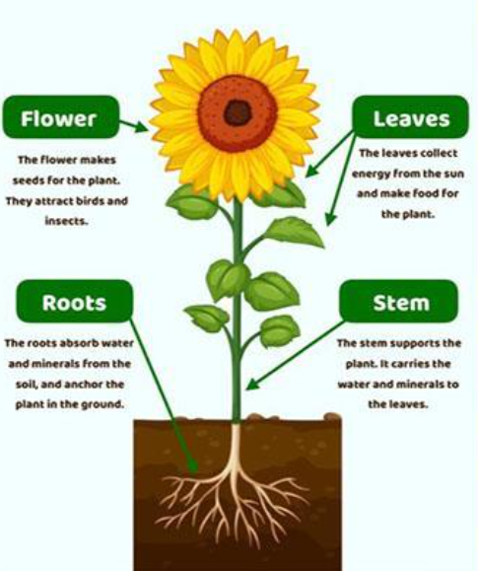
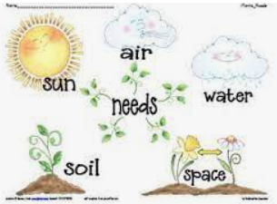
Young Gardeners: Knowledge Mat
Subject Specific Vocabulary |  |  | Sticky Knowledge about Plants
root | The part of the plant that grows downward. It gets water from the ground and holds the plant in place. | Important image to understand by the end of the Celebrations unit:
 |  |  | Plants have a root, stem, leaves and sometimes flowers. Flowers have petals and they often make nectar to attract insects.
stem | The part of the plant which grows upward and connects the roots with the leaves and flowers. It carries water and nutrients to the plant. |  | Plants have a root, stem, leaves and sometimes flowers. Flowers have petals and they often make nectar to attract insects.
leaf | The part of the plant which produces food for the plant. Leaves can be evergreen ( kept all year) or deciduous ( grown each year in the spring and dropped each autumn) |  | When flowers are pollinated by insects, they make seeds. The seeds then grow into a new plant this is called germination.
 |  |  | Plants need air, water, light and some warmth to grow ( some plants can grow in very cold conditions but they grow very slowly)
pollinate | Where pollen is transferred from one plant to another in order to pollinate a plant. When this happens the plant is able to make seeds.
 |  |  | Seeds need water, some warmth and light to grow.
seed | The part of a plant which can grow into a new plant. | Important image to understand by the end of the Celebrations unit: | Seeds need water, some warmth and light to grow.
 |  |  | Bulbs store energy in them and help a plant to survive in the winter. They start to grow when it becomes a bit warmer. They send out roots and shoots like a seed. Plants such as onion, garlic, tulip, daffodil, snowdrop and bluebells all have bulbs which stay in the ground all year around
bulb | The round underground part of some plants which stores energy for the plant to grow. |  | Bulbs store energy in them and help a plant to survive in the winter. They start to grow when it becomes a bit warmer. They send out roots and shoots like a seed. Plants such as onion, garlic, tulip, daffodil, snowdrop and bluebells all have bulbs which stay in the ground all year around
germinate | This is when the seed begins to grow. It uses the stored food in the seed to make roots and shoots. |  | Bulbs store energy in them and help a plant to survive in the winter. They start to grow when it becomes a bit warmer. They send out roots and shoots like a seed. Plants such as onion, garlic, tulip, daffodil, snowdrop and bluebells all have bulbs which stay in the ground all year around
tuber | The underground part of some plants which are like thickened stems. Plants such as potatoes have tubers.
nutrients | The food needed by plants which is found in the soil. Plants collect the nutrients through their roots.

