Slide 1
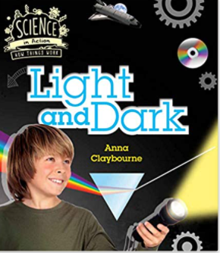
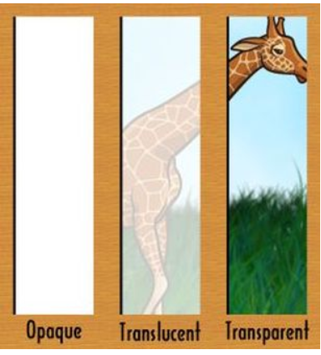
Light and Dark Knowledge Mat
Subject Specific Vocabulary |  | Interesting Books | Sticky Knowledge about light sources
light source | Something that gives out light
opaque | A material that does not let light through |  | Light sources can be man made ( torches, lamps, candles, ) some are natural ( sun, glow worms)
reflect | When light hits an object and bounces off
 | Also known as your backbone, your spine is a strong, flexible column of ring-like bones that runs from your skull to your pelvis. |  | Candles are made from wax and a wick. The wax melts when hot and turns from a solid to a liquid
translucent | A material that lets some light through but you can not see through it clearly | Important image to understand by the end of the Celebrations unit: | Lights sources vary in strength and can be measured by a light meter.
transparent | A material that lets light through and you can see through it clearly
shadow | The dark shape an opaque object makes when it is between the light source and the surface |  | Materials can be opaque, translucent or transparent
 |  |  | Opaque materials form shadows when lit from behind
adaption | How animals and plants change to ensure that they can live in their habitat
 |  |  | Nocturnal animals have a range of adaptions to help them navigate their world in the dark
nocturnal | Animals which are active at night and sleep during the day
 |  |  | Nocturnal animals are active in the night and asleep in the day
 |  |  | Nocturnal animals include hedgehogs, badgers, bats and owls

