Slide 1
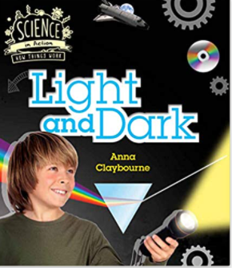
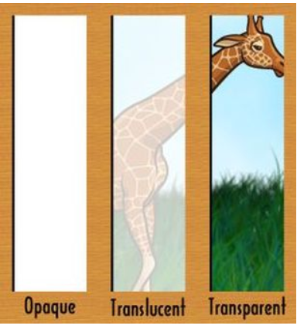
Light and Dark Knowledge Mat
Subject Specific Vocabulary |  | Interesting Books | Sticky Knowledge about light sources
light source | Something that gives out light
 |  |  | Light sources can be man made ( torches, lamps, candles, ) some are natural ( sun, glow worms)
opaque | A material that does not let light through |  | Light sources can be man made ( torches, lamps, candles, ) some are natural ( sun, glow worms)
reflect | When light hits an object and bounces off |  | Materials can be opaque, translucent or transparent
translucent | A material that lets some light through but you can not see through it clearly | Important image to understand by the end of the Celebrations unit: | Opaque materials form shadows when lit from behind
transparent | A material that lets light through and you can see through it clearly |  | Some materials can reflect light. We call these reflective materials and they are used to keep people safe in low light conditions.
shadow | The dark shape an opaque object makes when it is between the light source and the surface |  | Some materials can reflect light
 |  |  | Opaque materials form shadows when lit from behind
hibernation | When some animals ‘sleep’ through a period of cold weather in order to survive.
 |  |  | Nocturnal animals such as hedgehogs, badgers, bats and owls have super senses which help them navigate their world in the dark
nocturnal | Animals which are active at night and sleep during the day
 |  |  | Nocturnal animals are active in the night and asleep in the day
 |  |  | In winter there is less daylight and the weather turns colder. Some UK animals hibernate to survive the colder months. These animals are hedgehogs, bats and the dormouse.

