Slide 1
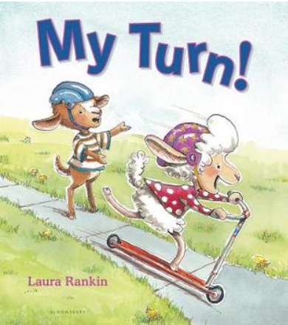
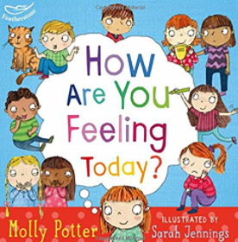
Personal,Social,Emotional Development : Building Relationships
Selection of linked objectives and ideas for supporting child development |  | Early Learning Goals | Useful Books
Develops particular friendships with other children, which help them to understand different points of view and to challenge their own and others’ thinking • Is increasingly flexible and cooperative as they are more able to understand other people’s needs, wants and behaviours | Support young children’s efforts to join in with others’ play and inviting others into their play. Provide play activities that encourage cooperation and collaboration, such as parachute activities and ring games. | Work and play cooperatively and take turns with others
Shows confidence in speaking to others about their own needs, wants, interests and opinions in familiar group | Plan regular opportunities for children to talk to their small group about something they are interested in or have done. | Form positive attachments to adults and friendships with peers
Talks about their own and others’ feelings and behaviour and its consequences Returns to the secure base of a familiar adult to recharge and gain emotional support and practical help in difficult situations | Ask children for their ideas on what might make people feel better when they are sad or cross. • Children with developmental differences such as Autism Spectrum Disorders may need additional support in developing empathy. Using role play opportunities, social stories and providing feedback can help a child to recognise their feelings of empathy | Show sensitivity to their own and to others’ needs
Talks about how others might be feeling and responds according to their his understanding of the other person’s needs and wants | Name and talk about a wide range of feelings and make it clear that all feelings are understandable and acceptable. Put children’s feelings into words for them: It looks like you’re cross about that.

