Slide 1
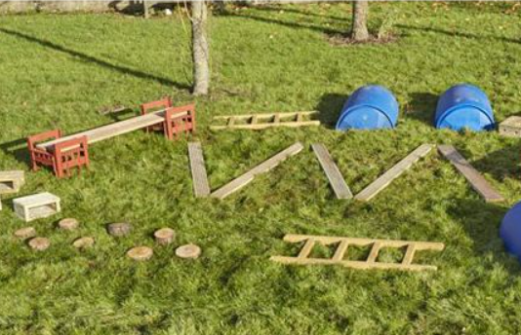
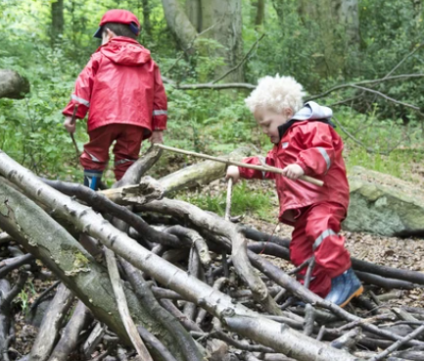
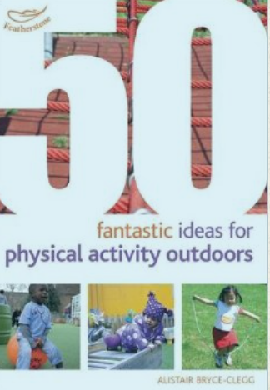
Physical Development : Gross Motor Skills
Selection of linked objectives and ideas for supporting child development |  | Early Learning Goals | Useful Resources
Experiments with different ways of moving, testing out ideas and adapting movements to reduce risk Negotiates space successfully when playing racing and chasing games with other children, adjusting speed or changing direction to avoid obstacles | Plan activities where children can practise moving in different ways and at different speeds, balancing, target throwing, rolling, kicking and catching | Negotiate space and obstacles safely, with consideration for themselves and others;
Chooses to move in a range of ways, moving freely and with confidence making changes to body shape, position and pace of movement such as slithering, shuffling, rolling, crawling, walking, running, jumping, skipping, sliding and hopping | Provide large portable equipment that children can move about safely and cooperatively to create their own structures, such as milk crates, tyres, large cardboard tubes. | Demonstrate strength, balance and coordination when playing;
Shows increasing control over an object in pushing, patting, throwing, catching or kicking it | Provide time and space to enjoy energetic play outdoors daily. Notice a child who lacks strength in limbs to push, pull or move safely over climbing equipment. Find out what opportunities the child has at home for outdoor adventure and risk and adapt routines to increase outdoor physical play. | Move energetically, such as running, jumping, dancing, hopping, skipping and climbing

