Slide 1
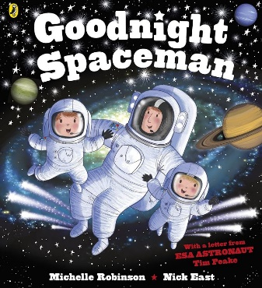
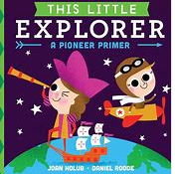
The Greatest Explorers: Knowledge Mat
Subject Specific Vocabulary |  | Interesting Books | Sticky Knowledge about Explorers
explorer | A person who explorers a new or unfamiliar area | Important image to understand by the end of the Celebrations unit:
trade | The action of buying and selling goods to another |  | Ibn Battuta, born in 1304 in Morocco, North Africa, spent 29 years travelling the world, earning him the title ‘the travelling man.’ He explored large parts of Africa and Asia. He was the most travelled man of his time.
expedition | A journey undertaken by someone for exploration, research or war
 | Also known as your backbone, your spine is a strong, flexible column of ring-like bones that runs from your skull to your pelvis. |  | In 1768, Captain Cook set off on his first voyage on the ship, Endeavour.. He mapped large parts of the Pacific Ocean including New Zealand and Australia/
Indigenous people | People who were the original owners or occupants of a particular land.
pirate | A person who attacks or robs ships at sea | Important image to understand by the end of the Celebrations unit: | Captain Cook is often criticised for his treatment of indigenous populations which means not everyone supports the view that he was a great explorer.
polar | Relating to the North or South pole.
 |  |  | Roald Amundsen was the first man to reach the South Pole in 1911, beating Captain Robert Scott by 16 days. Captain Scott died on his return journey.
equipment | The essential items for a particular purpose. |  | Roald Amundsen was the first man to reach the South Pole in 1911, beating Captain Robert Scott by 16 days.
 |  |  | In 2006 Sunita Williams went on her first expedition into space on the shuttle Discovery. The first female to travel in space was Valentina Tereshkova in 1963. The first female Brtiish astronaut was Helen Sharman.
astronaut | A person who is trained to travel in an spacecraft. |  | In 2006 Sunita Williams went on her first expedition into space on the shuttle Discovery. The first female to travel in space was Valentina Tereshkova in 1963.
memorial | A statue or structure built to remember a person or event

