Slide 1
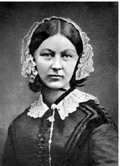
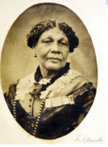

Florence Nightingale
What do I already know? How nurses help us Life was different in the past |  | This will help me in the future Understand how hospitals changed because of past events | Key Themes Significant Individuals and Social Change
Key Vocabulary |  | KEY CHANGES FLORENCE MADE: She cleaned the hospitals from top to bottom. The patients were served better food. The patients were given proper beds to sleep in. The nurses were made to wash their hands. When she returned home Florence set up a training school for nurses so they were better prepared.
 |  |  | Key Knowledge
Infection | An illness caused by spreading germs. |  | Keeping healthy includes looking after our mental health. Doing things that we enjoy releases chemicals in our brains which make us happy.
 |  |  | Florence Nightingale became a nurse because she felt that God wanted her to help people.
Crimean War | The war that Florence Nightingale and Mary Seacole served in.
 |  |  | A war started in Crimea and Florence went to go and look after the soldiers who had been hurt.
Patient | A person that is ill in hospital
Order of Merit | The award that Florence received for her amazing work |  | The hospitals where Florence worked were not very clean, the food was poor and they did not have many beds meaning infections spread.
Nurse | Somebody who helps and treat patients |  | The soldiers that Florence treated called her ‘The lady with the lamp’ because she walked around the wards at night with a lantern
Greater Depth Challenge: Who was Mary Seacole? How was she similar and different to Florence Nightingale? |  |  | Our grandparents went into shops to buy things, home delivery and internet shopping had not been invented. Some people used greengrocers, bakeries and butchers rather than supermarkets.
 |  |  | Florence was awarded the Order of Merit by Queen Victoria for her hard work.

