Slide 1
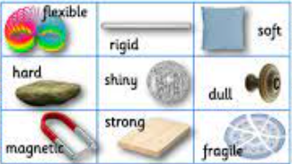
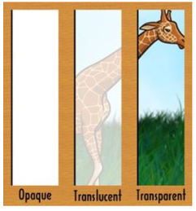
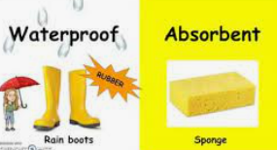
Materials Monster Knowledge Mat
Subject Specific Vocabulary |  |  | Sticky Knowledge about Materials
Materials | Something that an object is or can be made from, e.g. a saucepan can be made from metal.
 |  |  | I can identify and compare the suitability of a variety of everyday materials, including wood, metal, plastic, glass, brick, rock, paper and cardboard for particular uses
Properties | The characteristics of a material, e.g. glass can be transparent. Transparent is the property. |  | Keeping healthy includes looking after our mental health. Doing things that we enjoy releases chemicals in our brains which make us happy.
 |  |  | I know that the shape of solid objects can be changed by squashing, bending, twisting and stretching materials
Man made resources | A material or resource which is manufactured or made by humans often in factories. The material is not natural. |  | Our bodies need healthy food and drink to develop and grow. We need a balanced diet with enough energy, protein, calcium, fibre, vitamins and minerals to keep us well,
 |  |  | I can describe the properties of materials using the terms waterproof,absorbent, windproof, transparent, opaque, smooth, flexible and rigid.
Natural resources | Natural resources are materials that are 'naturally' found around us. We may have to dig them out of the ground, grow them, or take them from living things.
Natural resources | Natural resources are materials that are 'naturally' found around us. We may have to dig them out of the ground, grow them, or take them from living things. |  | I can name different materials – plastic, wood, metal, glass, fabric, pottery. I can identify what some objects are made from by using my senses.
Absorbent | A material which will soak up water
Waterproof | A material which does not absorb water
Rigid | A material which can not be bent, squashed, stretched, twisted |  | I know which materials can be bent, twisted, squashed and stretched. I can use terms rigid and flexible to describe materials which can and can not be made to change shape.
Flexible | A material which can be bent, squashed, stretched, twisted
Transparent | A material which you can see through |  | I know how metal, glass, wood and plastic can be manufactured into everyday products,
Opaque | A material which you can not see through

