Slide 1

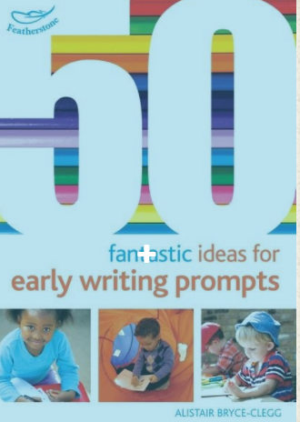
Literacy : Writing
Selection of linked objectives and ideas for supporting child development |  | Early Learning Goals | Useful Books
Gives meaning to the marks they make as they draw, write, paint and type using a keyboard or touch-screen technology | Talk to children about things they might write to support their play inside and outside, e.g. they might make a map for a journey, a job list for a builder, or spells for potion making. | Write recognisable letters, most of which are correctly formed;
Begins to break the flow of speech into words, to hear and say the initial sound in words and may start to segment the sounds in words and blend them together • Starts to develop phonic knowledge by linking sounds to letters, naming and sounding some of the letters of the alphabet, identifying letters and writing recognisable letters in sequence, such as in their own name | Talk to children about the letters that represent the sounds they hear at the beginning of their own names and other familiar words. • Model how to segment the sounds (phonemes) in simple words and how the sounds are represented by letters (graphemes). • Encourage children to apply their own grapheme/phoneme knowledge to what they write in meaningful contexts. | Spell words by identifying sounds in them and representing the sounds with a letter or letters
 |  | Write simple phrases and sentences that can be read by others
Uses their developing phonic knowledge to write things such as labels and captions, later progressing to simple sentences | Resource role-play areas with listening and writing equipment, and ensure that role-play areas encourage writing of signs with a real purpose, e.g. a pet shop.

