Slide 1
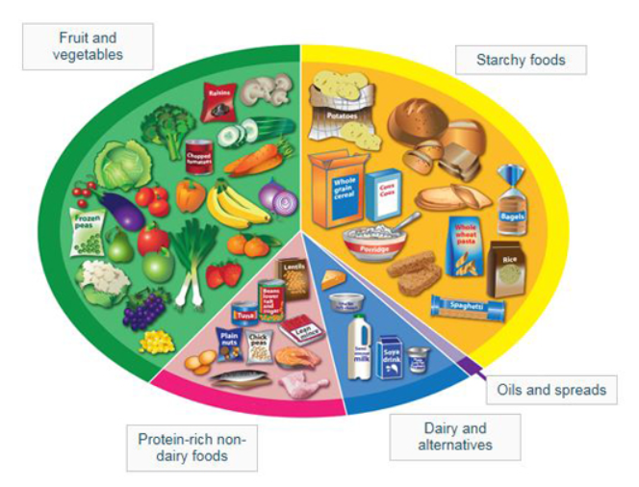

Healthy Me Knowledge Mat
Subject Specific Vocabulary |  |  | Sticky Knowledge about being Healthy
Exercise | Moving parts of the body to become stronger and healthier | The Eat Well Plate Children need to take part in exercise for 60 minutes per day
 |  |  | Keeping healthy includes looking after our mental health. Doing things that we enjoy releases chemicals in our brains which make us happy.
Healthy | Feeling well and happy |  | Keeping healthy includes looking after our mental health. Doing things that we enjoy releases chemicals in our brains which make us happy.
 |  |  | Our bodies need healthy food and drink to develop and grow. We need a balanced diet with enough energy, protein, calcium, fibre, vitamins and minerals to keep us well,
Hygiene | The things we do to keep our body clean and help stop the spread of germs. |  | Our bodies need healthy food and drink to develop and grow. We need a balanced diet with enough energy, protein, calcium, fibre, vitamins and minerals to keep us well,
 |  |  | Sweets, crisps, chocolate and fizzy drinks should only be eaten as a treat and not every day.
Germs | Germs are tiny living things we cannot see with our eyes. They live on our bodies and can cause disease. |  | Our bodies are made of muscles and bones. They need exercise to keep them healthy. We should do some exercise which leaves us out of breath every day.
Balanced diet | A diet that has foods from the five different food groups – starchy food, protein, dairy, fruit and vegetables, oils and fats |  | Our bodies need sleep to help them recover and rebuild. Young children should have 11 hours sleep a night if possible.
 |  |  | Hygiene or keeping our bodies clean is important to stay healthy. Wash your hands before you eat and after you have been to the toilet.

