Slide 1
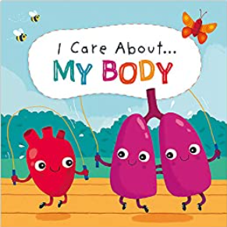
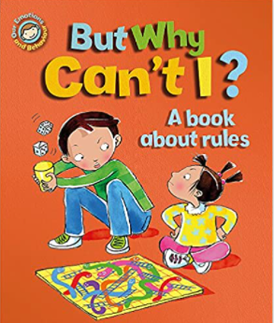
Personal, Social, Emotional Development : Managing Self
Selection of linked objectives and ideas for supporting child development |  | Early Learning Goals | Useful Books
Shows their confidence and self-esteem through being outgoing towards people, taking risks and trying new things or new social situations and being able to express their needs and ask adults for help | Offer help with activities when asked but not before and see struggle and mistakes as important parts of learning. Provide experiences and activities that are challenging but achievable. | Be confident to try new activities and show independence, resilience and perseverance in the face of challenge
Understands that expectations vary depending on different events, social situations and changes in routine, and becomes more able to adapt their behaviour in favourable conditions | Discuss rules and fairness with young children and show positive appreciation of young children’s pro-social behaviours of kindness and helpfulness for example. | Explain the reasons for rules, know right from wrong and try to behave accordingly
Attempts to repair a relationship or situation where they have caused upset and understands how their actions impact other people | Offer environments that include stimulating and challenging spaces but also calm and comfortable spaces. | Manage their own basic hygiene and personal needs, including dressing, going to the toilet and understanding the importance of healthy food choices
Has a clear idea about what they want to do in their play and how they want to go about it • Shows confidence in choosing resources and perseverance in carrying out a chosen activity | Notice and appreciate young children’s efforts not just their achievements, encouraging their inner motivation rather than working just for your approval or a sticker.

