Slide 1
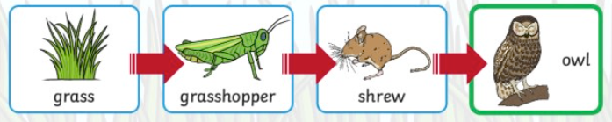
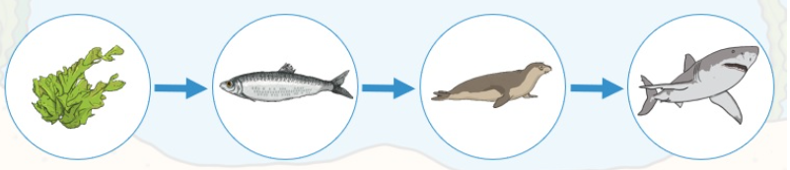

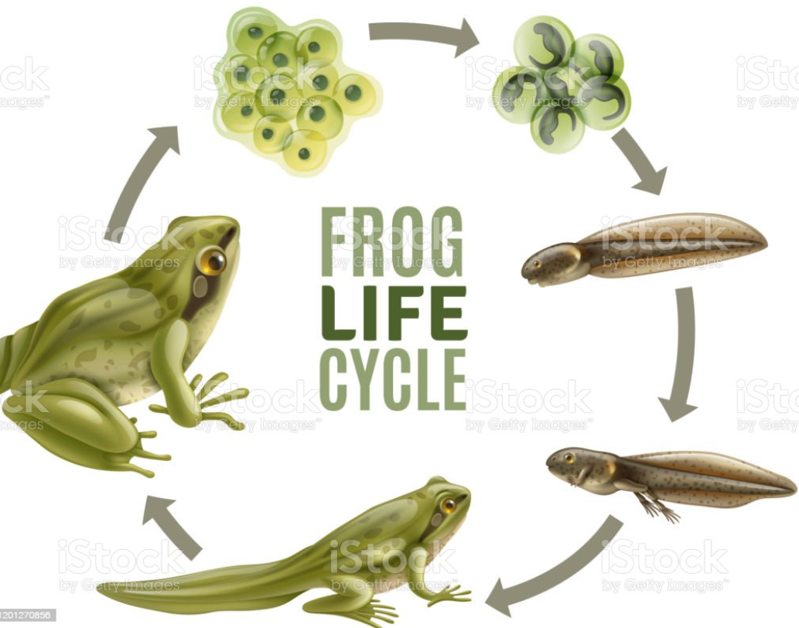
Mini-Worlds Knowledge Mat
Simple food chains |  | Interesting Books | Sticky Knowledge about Mini-worlds
 |  |  | A food chain is made up of animals and plants. It shows what each animal eats.
 | Also known as your backbone, your spine is a strong, flexible column of ring-like bones that runs from your skull to your pelvis. |  | Herbivores are animals which feed on plants
 |  |  | Omnivores are animals which eat both meat and plants eg foxes and humans
Subject SSubj |  |  | A carnivore is an animal which eats other animals ( meat)
habitat | A place which provides everything a living thing needs to survive : food, water, air and shelter. |  | A mammal is an animal which gives birth to live young which drink milk
 |  |  | A habitat contains all the elements needed for an animal to survive : food, water, shelter
extinct | An animal or plant which was alive but now there are no more of them living on planet Earth,,
 |  |  | Fossils are the remains of plants or animals which lived a long time ago.
fossil | Fossils are the remains of plants or animals which lived a long time ago. Often their remains are left as an imprint in rocks.
 |  |  | An animal is alive if it eats food, breathes and has young.
food chain | This describes what each animal eats. Arrows are used to show which animal eats what.
 |  |  | A lifecycle describes the journey of a living thing from beginning to end.
lifecycle | This describes how a living thing begins life, grows and matures

