Slide 1
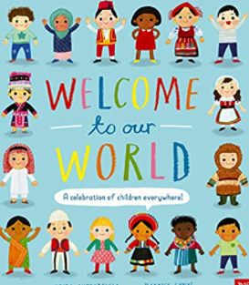
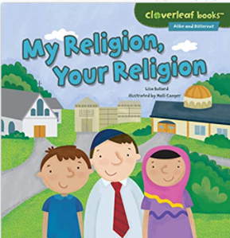
Understanding the World : People, Culture and communities
Selection of linked objectives and ideas for supporting child development |  | Early Learning Goals | Useful Books
Draw information from a simple map | Draw children’s attention to their immediate environment introducing and modelling new vocabulary Familiarise them with the name of the road, village, town, city the school is located in Look at aerial views of the school setting and note features Offer opportunities to make simple maps of their immediate environment and maps from imaginary story settings that they are familiar with | Describe their immediate environment using knowledge from observation, discussion, stories, non-fiction texts and maps;
Understand that some places are special to members of their community Recognise that people have different beliefs and celebrate special times in different ways | Name and explain the purpose of places of worship and places of local importance to the community Take children to places of worship and places of local importance Invite visitors from different religious and cultural communiities into the classroom to share their experiences Weave opportunities for children to engage with religious and cultural communities in their practices throughout the curriculum at appropriate times of the year, | Know some similarities and differences between different religious and cultural communities in this country, drawing on their experiences and what has been read in class
 |  | Explain some similarities and differences between life in this country and life in other countries, drawing on knowledge from stories, non-fiction texts and – when appropriate – maps
Recognise some similarities and differences between life in this country and life in other countries | Teach children about places in the world that contrast with our location Use relevant vocabulary to describe contrasting locations Use images, video clips, books and other resources to bring the wider world into the classroom Avoid stereotyping and explain how lives can be different in terms of travel to school, what they eat, where they live and so on

