Slide 1
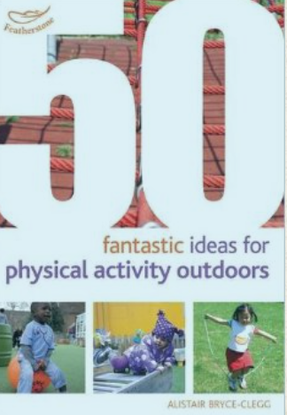
Physical Development : Gross Motor Skills
Selection of pre-school objectives and ideas for supporting child development |  | End of pre-school observation checkpoint | Useful ideas to try at home
Continue to develop their movement, balancing, riding (scooters, trikes and bikes) and ball skills. Go up steps and stairs, or climb up apparatus, using alternate feet. Skip, hop, stand on one leg and hold a pose for a game like musical statues. Use large-muscle movements to wave flags and streamers, paint and make marks. | We provide a wide range of resources to encourage and develop movement skills. We have scooters, trikes and all sorts of ball games to try. Climbing apparatus is part of our daily provision as is PE equipment to encourage the development of motor skills. Regular trips to playgrounds as well as opportunities to mark make on a large scale is useful – use an old paint brush and water to help children develop their arm and shoulder muscles whilst ‘painting’ the door for you for example. | Can children throw and catch a large ball Can children try to skip, hop and balance Can children pedal a tricycle, Can children ride a scooter and manoeuvre around obstacles Can children climb confidently using alternate feet Can children follow a basic sequence of movements
Increasingly be able to use and remember sequences and patterns of movements which are related to music and rhythm. | Model the vocabulary of movement – ‘gallop’, ‘slither’ – and encourage children to use it. Also model the vocabulary of instruction – ‘follow’, ‘lead’, ‘copy’ – and encourage children to use it.
Choose the right resources to carry out their own plan. For example, choosing a spade to enlarge a small hole they dug with a trowel. Collaborate with others to manage large items, such as moving a long plank safely, carrying large hollow blocks. | Explain why safety is an important factor in handling tools and moving equipment and materials. Have clear and sensible rules for everybody to follow.

