Slide 1
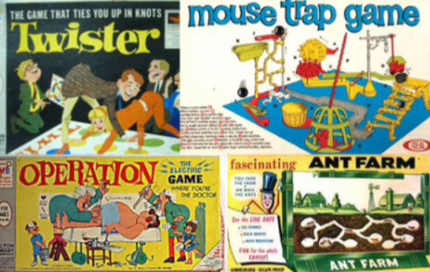
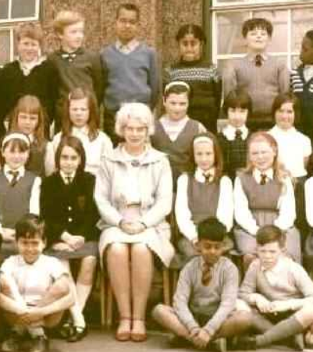
Family History Knowledge Mat
Subject Specific Vocabulary |  |  | Sticky Knowledge about Family History
Time line | A horizontal line where dates and facts are added in chronological order. | 1960’s games Typical 1960’s school uniform
 |  |  | Some parts of the past are similar to our own experiences but some are different.
Oral history | A way of finding out about the past by listening to the stories of the past spoken by a family member |  | Keeping healthy includes looking after our mental health. Doing things that we enjoy releases chemicals in our brains which make us happy.
 |  |  | A timeline can help us understand where we fit in our family history.
 |  |  | Children are able to ask questions about the past and are able to present the answers to these questions.
Greengrocer | A shop selling fruit and vegetables. |  | Children are able to ask questions about the past and are able to present the answers to these questions.
Butcher | A shop selling meat |  | There were no computers, no mobile phones and no internet when our grandparents were born.
Bakery | A shop selling bread products
High Street | A line of shops selling everyday items |  | Our grandparents went into shops to buy things, home delivery and internet shopping had not been invented. Some people used greengrocers, bakeries and butchers rather than supermarkets.
Board games | A game played on a table top, often using a dice and counters. Board games are usually played with 2 or more people. |  | Our grandparents went into shops to buy things, home delivery and internet shopping had not been invented. Some people used greengrocers, bakeries and butchers rather than supermarkets.
Balanced diet | A diet that has foods from the five different food groups – starchy food, protein, dairy, fruit and vegetables, oils and fats |  | Our grandparents, played outside, played board games, read books and watched a small amount of children’s television or radio.
Children’s hour | An hour or so on the television every day when all the programmes were designed for children. The rest of the time, the television programmes were for adults.
 |  |  | School might have felt more strict for our grandparents and they might have been taught different ways of doing things.

