Slide 1
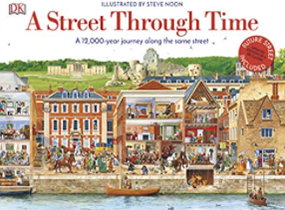
Understanding the World : Past and Present
Selection of linked objectives and ideas for supporting child development |  | Early Learning Goals | Useful Books
Talk about members of their family and community Name and describe people who are familiar to them | During dedicated talk time, listen to what children say about their family Share information about your own family and roles, giving time for children to ask questions and make comments Using examples from real life and books, show children that there are many different families Talk about people they may have come into contact with in their community : fire, police, doctors, teachers, nurses, dentist. Listen to what children have to say about these experiences | Talk about the lives of the people around them and their roles in society
Comment on images of familiar situations in the past | Present children with picture, stories, artefacts and accounts from the past, explaining similarities and differences Offer hands on experiences to deepen children’s understanding of the past Show images of familiar setttings – homes, schools, transport Offer opportunities to organise events using basic chronology – before and after they were born etc | Know some similarities and differences between things in the past and now, drawing on their experiences and what has been read in class
 |  | Understand the past through settings, characters and events encountered in books read in class and storytelling
Compare and contrast characters from stories, including figures from the past | Share texts that help chn make sense of past and present Draw out common themes from stories – bravery, difficult choices, kindness and talk about children’s experiences with these themes

