Slide 1
How can I support my child secure key maths skills ?
A Parents Guide to KIRFS

Slide 2
Key Maths Skills
At school we know you are keen to support your child in acquiring key skills to help them do well at school and to acquire skills for life.
In Maths when we were at school, this largely involved learning our times tables.
Things have moved on since we were all at school and there are other key skills as well as times tables that will help your child find maths in school easier.
These facts are called Key Instant Recall Facts or KIRFS
These key skills replace the old Maths Passports we were using.

Slide 3
What are KIRFS and why do children need to know them ?
KIRFS are the everyday maths facts we need to know off by heart to make our maths calculations and maths lessons easier.
If we know these key facts then our brains are not so overloaded when we tackle hard maths problems.
Key facts include times tables, number bonds, telling the time, knowing left from right, saying the months of the year in order, knowing how many days in each month, counting forwards and backwards, counting in 25’s, 50’s, knowing your prime numbers, being able to divide by 10 and 100 etc.

Slide 4
When will I be told about the KIRFS I need to help my child with ?
Every term your child will be issued with a set of KIRFS for that term.
Copies of the KIRFS are also posted on the school website.
Sometimes some of the KIRFS are repeated because we know they take time to learn.
Each KIRF will have a visual representation to show you what they are eg Number bonds are explained because this is new to many of us.
If you are unsure, please do ask your child’s teacher who will be happy to explain and support.

Slide 5
How often should we practise our KIRFS ?
Learning these key facts should not be too onerous for you or your child. Learning should never become a battleground.
Perhaps consider making flashcards to learn the times tables with the question on one side of a card and the answer on the other so that they can check their answer. Consider learning just three times table or number bond facts a day.
Telling the time could be done whilst making dinner.
Practise little and often is usually the key when learning things off by heart with young children.

Slide 6
What will you be doing in school to help support my child learn these facts ?
Every morning when children enter school, we have 15 minutes of early morning activities. These include key spellings, handwriting practise and mental maths.
Times tables, number bonds and KIRFS will form the maths elements for this practise on three of the five days. The other two days will be spent on arithmetic.
Practising at home is important however as these facts take time to learn and children make best progress when supported at home.

Slide 7
Homework Support
Some of your child’s homework may support the KIRFS being learnt. However, homework tends to be completed just once a week and this makes learning things off by heart quite difficult for children.
Please try to support your child learning these facts more than once a week to ensure that they find this process easier.
If you have any further questions, please do come and talk to us. We are very happy to support you and your child.

Slide 8
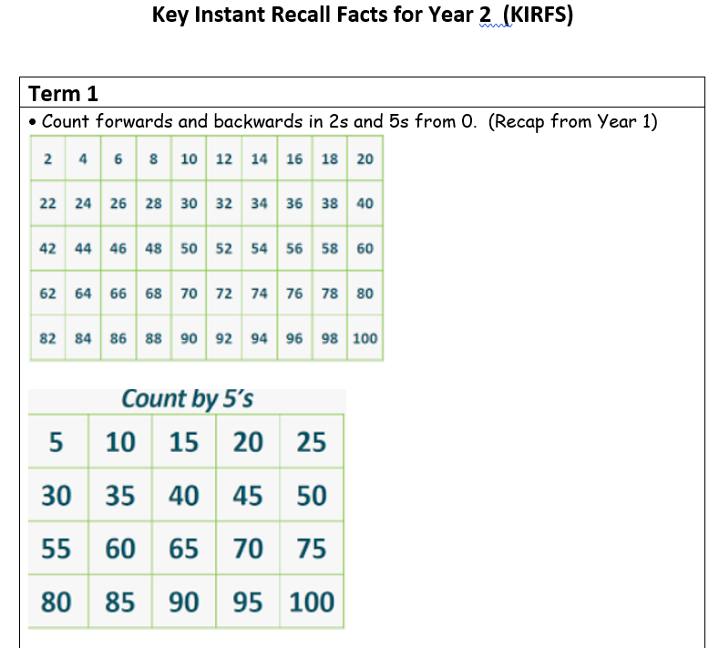
Some examples of KIRFS from this term : KS1

Slide 9
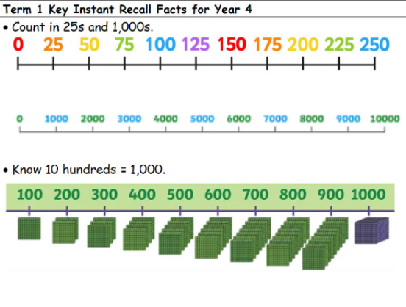
Some examples of KIRFS for Y3 and Y4

Slide 10
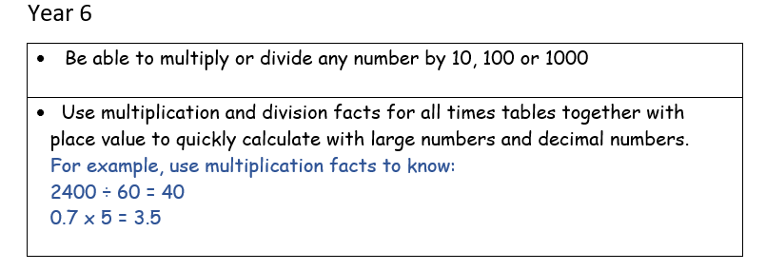
Some examples of KIRFS for Y5 and Y6

