Slide 1
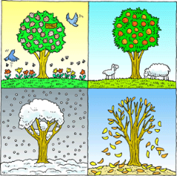
Seasonal Change Knowledge Mat
Subject Specific Vocabulary |  | Interesting Book | Sticky Knowledge about seasonal change
Autumn | The time of year between September and November. Many leaves fall off the trees.
Spring | The time of year between March and May. There is usually lots of signs of new growth in Spring.
 |  |  | In the UK we have four seasons: spring, summer, autumn and winter. Summer is the hottest season and winter the coldest.
Summer | The hottest season in the UK. It happens between June and August. The longest day is June 21st.
 |  |  | Spring starts when the day and night are the same length (usually 21st March. However, many say that Spring starts on March 1^{st)}.
Winter | The coldest season in the UK. We can have snow in this season. It occurs between December and February.
Fall | The name given to the Autumn season by Americans. It is because so many leaves fall off the trees.
 |  |  | In summer the longest day of the year is around June 21st and in winter the shortest day of the year is usually December 21st.
weather | Weather is what the sky and the air outside are like, such as cold and cloudy.
temperature | It is measurement of hot or cold that can be measured using a thermometer.
 |  |  | When we have our summer it is winter in the southern hemisphere. When we have our winter Australia has its summer.
thermometer | This is the instrument that measures the temperature.
weather symbol | These are signs used to help us understand more about our daily weather. |  | In the USA and many other countries the season ‘Autumn’ is known as the ‘Fall’. This is because so many leaves fall from the trees in Autumn.
deciduous | Deciduous trees are trees that shed their leaves once a year, usually during the season of autumn.
coniferous | Most conifers are evergreens, or trees that keep their leaves year-round. |  | Seasons change throughout the year because of the way the Earth travels around the Sun.

