Slide 1
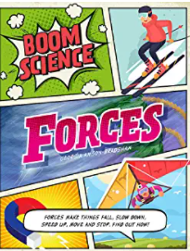
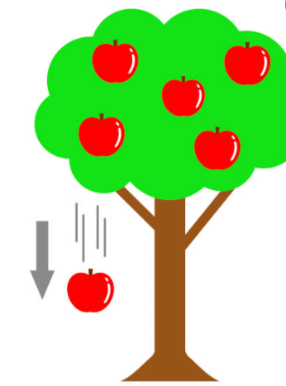
Move it ! Knowledge Mat
Subject Specific Vocabulary |  | Interesting Books | Sticky Knowledge about forces
bend | To force something which is straight into a curve or an angle | What is a force ?
stretch | To pull something and make it longer |  | Some materials can change their shape by being squashed, bent, twisted and stretched
 | Also known as your backbone, your spine is a strong, flexible column of ring-like bones that runs from your skull to your pelvis. |  | That a force can be a push or a pull force
squash | To push something together so that it changes shape.
twist | Something that is twisted, curled or made into a spiral |  | That a force needs to be applied to an object for it to be moved. That the degree of force needed to move things varies.
push | To move something away from you |  | That forces are applied to everything on Earth( gravity)
pull | To move something towards you |  | That forces are applied to everything on Earth( gravity)
 |  |  | Some materials can not change shape because they are rigid
gravity | A force that pulls everything towards the centre of the Earth
 |  |  | Some materials are elastic and can return to their original shape when the force which changed their shape is removed
elastic | Materials which are elastic, return to their original shape after they have been stretched
 |  |  | In space, there is no gravity and so things float in space

