Slide 1
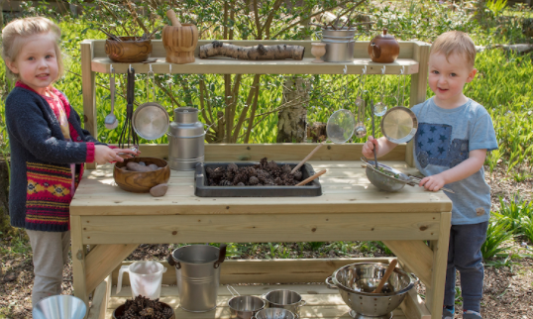
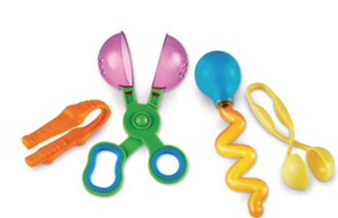
Physical Development : Fine Motor Skills
Selection of linked objectives and ideas for supporting child development |  | Early Learning Goals | Useful Resources
Shows a preference for a dominant hand • Begins to use anticlockwise movement and retrace vertical lines • Begins to form recognisable letters independently • Uses a pencil and holds it effectively to form recognisable letters, most of which are correctly formed | Provide activities that give children the opportunity and motivation to practise manipulative skills, e.g. cooking, painting, clay and playing instruments. Support children with physical difficulties with nonslip mats, small trays for equipment, and triangular or thicker writing tools. Ensure left handed children have left handed equip | Hold a pencil effectively in preparation for fluent writing – using the tripod grip in almost all cases
Use their core muscle strength to achieve a good posture when sitting at a table or sitting on the floor Provide a variety of activities to further refine fine motor skills – match activity to different levels of skill and confidence as the year progresses | Provide chairs that are at the right height for the desk Ensure tables are the correct height to support forearms Teach children skills of how to use tools and materials effectively and safely and give them opportunities to practise them. | Use a range of small tools, including scissors, paint brushes and cutlery
 |  | Begin to show accuracy and care when drawing

