Slide 1
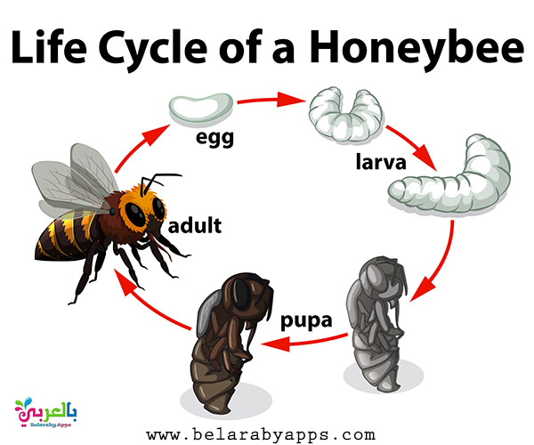
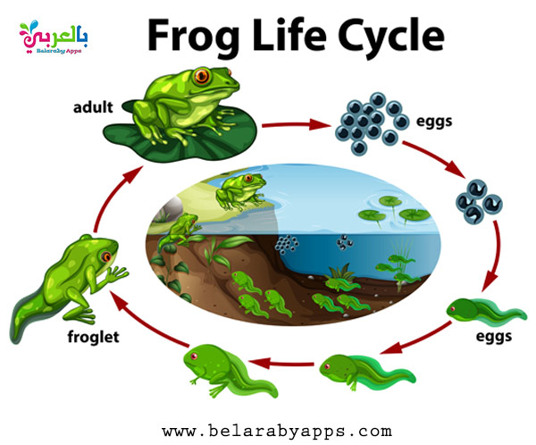
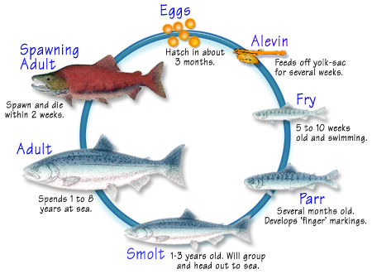
Upper KS2: Circle of Life organiser
Subject Specific Vocabulary |  |  | Sticky Knowledge about life cycles
Bulb: | A round underground part of a plant that stores food and can grow into a new plant
Pollination: | when pollen from one plant is transferred to the ovary of another. |  | Different animals have different life cycles. Insects all go through a larval stage, which may last for years. A bird life cycle begins with an egg, laid outside the body, from which a baby bird is born. Some animals, like frogs, undergo metamorphosis, where the adult looks totally different. Most plants reproduce by producing seeds (this is sexual reproduction). Others can grown from bulbs, runners or cuttings. All animals grow from an egg. In insects, fish and amphibians, this egg is a ball of jelly and the baby develops inside. Birds and reptiles lay larger eggs with a shell. Bird eggs have hard shells and reptiles have leathery shells. The baby develops inside and then hatches when it is ready to come out. Mammals’ eggs stay inside their mother, where they grow inside the womb. This period of growth is called gestation. Many animals release millions of sperm/thousands of eggs at a time to improve their chances of fertilisation.
Fertilisation: | when an egg and pollen (or sperm) join together.
Sexual reproduction: | to reproduce with both a male and female. |  | It takes blood around 20 seconds to travel around your body. Blood is what is used to transport oxygen, waste, nutrients, and more throughout the body.
Asexual reproduction: | When one living thing makes a new living thing on its own, without needing another parent. |  | The circulatory system includes the heart, blood vessels and blood, and is vital for fighting diseases and maintaining proper temperature.
Larva: | The young form of some animals, such as a caterpillar or tadpole, before it changes into an adult
Gestation: | when a baby animal develops inside its mother.
Metamorphosis: | a dramatic change in the life cycle of an animal in which it ends up looking totally different. |  | When you exercise, your muscles have to work harder: they need more oxygen and nutrients so the heart and lungs both work more quickly.
Sperm: | A male sex cell that can join with an egg cell to help make a new living thing. |  | When you exercise, your muscles have to work harder: they need more oxygen and nutrients so the heart and lungs both work more quickly.
Egg: | A female sex cell in animals that can join with a sperm cell to start making a baby animal.
Internal fertilisation: | when sperm and egg join inside the body.
External fertilisation: | when sperm and eggs join outside the body

