Slide 1
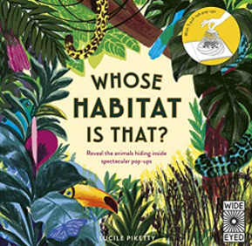
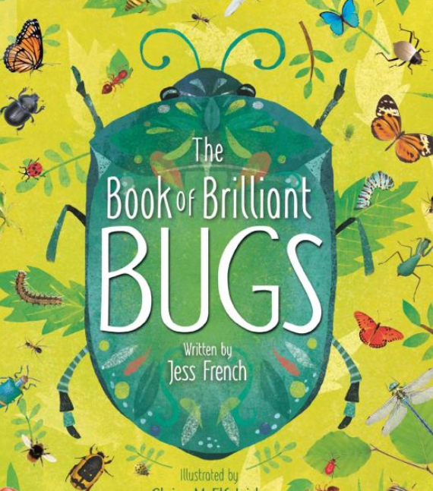
On Safari Knowledge Mat
Subject Specific Vocabulary |  | Interesting Books | Sticky Knowledge
invertebrates | An animal without a backbone
 |  |  | I know that an invertebrate is made up of three parts : head, thorax and abdomen
vertebrate | An animal with a backbone
 |  |  | I know that an Invertebrates do not have backbone but has an exoskeleton instead to support their body
exoskeleton | An external hard body covering providing support and protection
rockpool | They form in small and large spaces between rocks that have no gaps to let the water out. The water in tide pools changes every time the tide rises to cover them. Seaweeds and sea shore animals, such as crabs, small fish, and sea anemones, can live in these pools. |  | Invertebrates have at least 3 pairs of legs and at least 2 pairs of wings.
head | The first part of the invertebrate containing the eyes, mouth parts and antennae
abdomen | This is the third and last part of an invertebrate and contains the digestive system ( stomach ) and reproductive parts. | Scientific skills
 |  | Conduct a bug hunt using nets, pooters and observation | I know that :carnivores eat meat ; herbivores eat plants; omnivores eat both meat and plants
thorax | This is the middle part of an invertebrate and has wings ( two pairs) and legs ( three pairs)
 |  | Observe closely to identify an invertebrate, using field guides as needed
antennae | Feelers on the head that allow the invertebrate to sense its environment ( see , hear, feel and smell) |  | I can say where some invertebrates live ( describe their habitat) I can identify some common invertebrates commonly found in gardens.
 |  | Draw and accurately label the parts of an invertebrate.
habitat | An environment where an animal lives. It provides food, water and shelter. | Identify the key features of the habitat in which the invertebrate was found.

