Slide 1
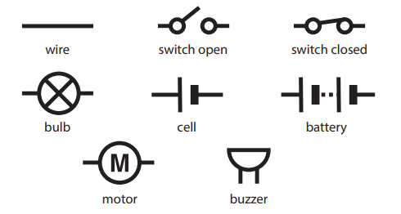
Electricity Knowledge Organiser Mighty Oaks
Subject Specific Vocabulary |  | Electrical symbols
conductor | Some materials let electricity pass through them easily. These materials are known as electrical conductors.
insulator | Plastic, wood, glass and rubber are good electrical insulators. They do not allow electricity to pass through.
insulator | Plastic, wood, glass and rubber are good electrical insulators. They do not allow electricity to pass through
electrons | Electricity is made up of negatively charged particles called electrons.
series circuits | A series circuit is one that has more than one resistor, but only one path through which the electricity (electrons) flows.
cell | A cell is a device that generates electricity, supplying power to a circuit. |  | A circuit must be complete from electricity to flow around it.
battery | A series of cells joined together
component | Something that makes up part of an electrical circuit, such as a buzzer or wire. | What you will know / be able to do by the end of the unit | Sticky knowledge for this unit
fuse | A safety device that will melt and make a break in a circuit if there is too much electricity. | Know that the brightness of a bulb is associated with the voltage. Compare and give reasons for variations in how components function. Use recognised symbols when representing a simple circuit in a diagram. Construct simple series circuits. Be able to answer questions about what happens when they try different components, for example; switches, bulbs, buzzers and motors. | A circuit must be complete for electricity to flow around it.
Thomas Edison | He was an inventor that came up with a way of making the electric light bulb accessible for homes, industry and outside in the streets. He also invented more than 2000 new products, including almost everything needed for us to use electricity in our homes: switches, fuses, sockets and meters. |  | Electricity will not travel from positive to positive or negative to negative.
Thomas Edison | He was a great inventor that came up with a way of making the electric light bulb accessible for homes, industry and outside in the streets. |  | Electricity travels at the speed of light – more than 300,000 km/second!
current | Current is the flow of an electric charge. It is an important quantity in electronic circuits. Current flows through a circuit when a voltage is placed across two points of a conductor |  | Electricity is a type of energy that builds up in one place (static), or flows from one place to another (current electricity).
generator | A machine that converts energy into electricity. |  | If more components (e.g. lamps) are added to a circuit, they will have less power (lamps will be less bright. If more cells are added, the power increases.
lamp

