Slide 1
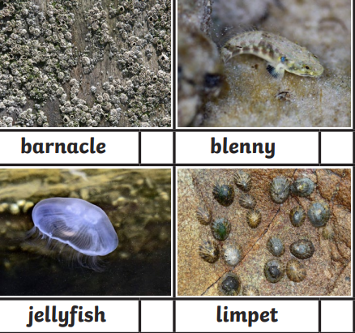
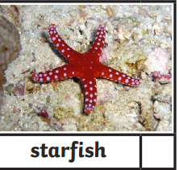
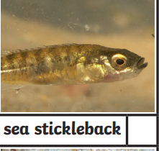
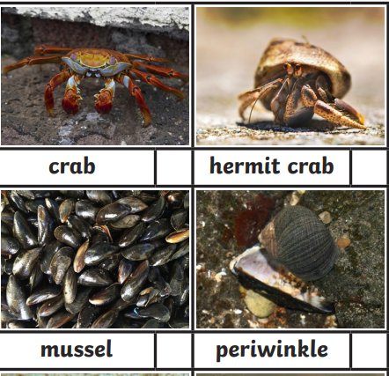
Coastal Habitats and Animals Knowledge Mat
Subject Specific Vocabulary |  | Rockpool animals | Sticky Knowledge about coasts
coastal habitat | The coast is the area between the sea and the land. A habitat is a place where animals live. A coastal habitat is special sort of habitat.
 |  |  | A habitat is a place that an animal lives. It provides the animal with food, water and shelter.
tide | Tides are the rise and fall of the ocean. Every day there are two high tides and two low tides.
rockpool | They form in small and large spaces between rocks that have no gaps to let the water out. The water in tide pools changes every time the tide rises to cover them. Seaweeds and sea shore animals, such as crabs, small fish, and sea anemones, can live in these pools. |  | Animals are adapted to the habitat they live in. Limpets attach themselves to rocks when the tide goes out so that they do not dry out in the sun.
rockpool | They form in small and large spaces between rocks that have no gaps to let the water out. The water in tide pools changes every time the tide rises to cover them. Seaweeds and sea shore animals, such as crabs, small fish, and sea anemones, can live in these pools. |  | A food chain is a sequence that tells us what each animal in the sequence eats
food chain | A food chain shows how energy is passed between plants and animals. A food chain tells us what each animal in the chain eats
 |  |  | A carnivore is an animal which eats only meat. An orca whale is a carnivore – it eats seals and fish.
carnivore | An animal that only eats meat.
herbivore | An animal that only eats plants. |  | A herbivore is an animal which only eats plants. Limpets are herbivores – they eat seaweed.
omnivore | An animal that eats meat and / or plants
 |  |  | An omnivore is an animal which eats meat and plants. Black backed gulls are omnivores eating seaweed and fish.

