Slide 1
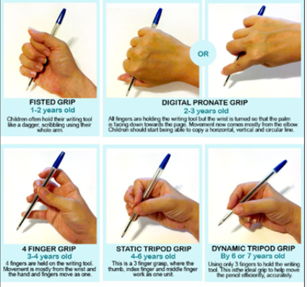
Physical Development : Fine Motor Skills
Selection of pre-school objectives and ideas for supporting child development |  | End of pre-school observation checkpoint | Useful ideas to try at home
Use one-handed tools and equipment, for example, making snips in paper with scissors. | You can begin by showing children how to use onehanded tools (scissors and hammers, for example) and then guide them with hand-over-hand help. Gradually reduce the help you are giving and allow the child to use the tool independently. | Children can use some one handed tools with some support as needed Children can hold a pencil more comfortably Children can get dressed and undressed with minimal help
Use a comfortable grip with good control when holding pens and pencils. Show a preference for a dominant hand. | The tripod grip is a comfortable way to hold a pencil or pen. It gives the child good control. The pen is pinched between the ball of the thumb and the forefinger, supported by the middle finger with the other fingers tucked into the hand. You can help children to develop this grip with specially designed pens and pencils, or grippers. Encourage children to pick up small objects like individual gravel stones or tiny bits of chalk to draw with.
Be increasingly independent as they get dressed and undressed, for example, putting coats on and doing up zips. | Encourage children by helping them, but leaving them to do the last steps, such as pulling up their zip after you have started it off. Gradually reduce your help until the child can do each step on their own.

