Slide 1
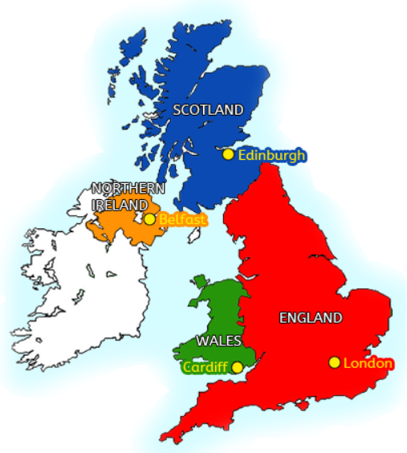
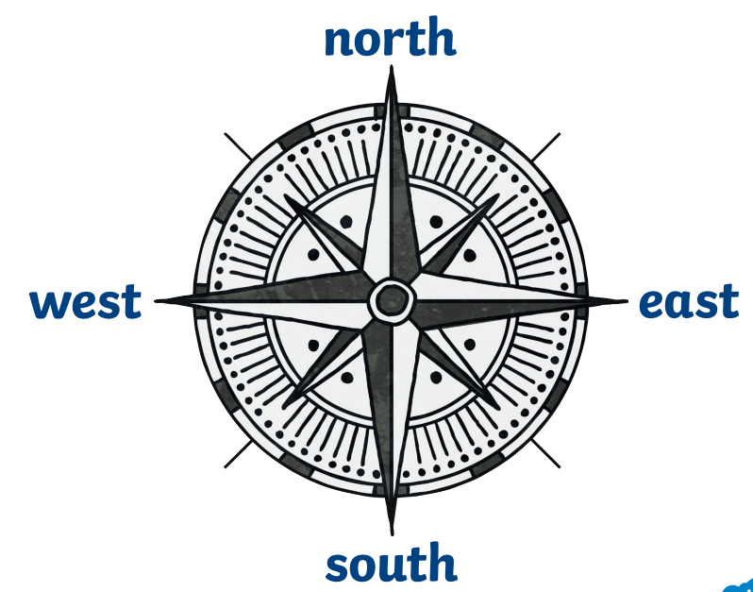
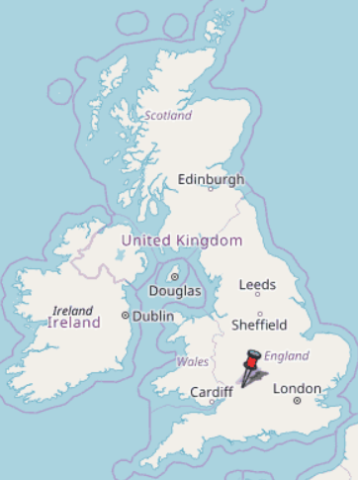
Our Local Area Knowledge Mat
Subject Specific Vocabulary |  |  | Sticky Knowledge about maps and fieldwork
. | . | nit:
 | . |  | I can identify where we live within the UK on a map.
 |  |  | I know that the UK is made up of 4 countries : England, Scotland, Wales and Northern Ireland. I know that London is the capital of the UK
Capital city | London is the capital city of the United Kingdom. A capital city is where the government of a country is based. | Important image to understand by the end of the Celebrations unit: | I know that a map gives us an aerial view of our world I can make a simple map of the school and it’s immediate features
United Kingdom | The name of our country. It is made up of 4 nations : England, Scotland, Wales and Northern Ireland. | Where is Gloucestershire ?
map | A map is a picture of a place, usually drqwn from above. We have maps of the world, maps of the UK, maps of our local area as well as sketch maps of our school grounds. |  | I know the basic compass points, : North, South, East and West and I can use these to give directions
 |  |  | I know that Bibury is a village and I can talk about the physical and human features of the area using the following terms : River, Coln, Rack Isle, Arlington Row, stream, Lady Hill, wood, field, valley, St Marys Church, post office, road, bridge, hotel, footbridge, town)
village | These are small places which are home to a few hundred people. Some villages have a shop but some do not.
compass | A device used to give us directions North, South, East and West

