Slide 1
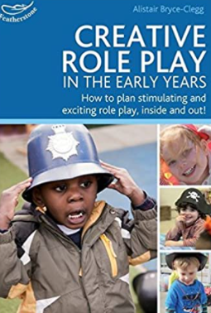
Expressive Arts and Design : Imaginative Play and Creativity
Selection of pre-school objectives and ideas for supporting child development |  | End of pre-school observation checkpoint | Useful books
Take part in simple pretend play, using an object to represent something else even though they are not similar. Begin to develop complex stories using small world equipment like animal sets, dolls and dolls houses, etc. Make imaginative and complex ‘small worlds’ with blocks and construction kits, such as a city with different buildings and a park. | Children generally start to develop pretend play with ‘rules’ when they are 3 or 4 years old. Suggestion: offer pinecones in the home corner for children to pour into pans and stir like pasta. Some rules are self-created (the pole is now a horse, or the pinecones are now pasta in the pot). Other rules are group-created (to play in the home corner, you must accept the rule that one of your friends is pretending to be a baby). We provide a broad variety of small world equipment for children to develop their imaginations. We also provide a good selection of role play equipment matched to children’s interests. | Are children able to engage in their own imaginative play? Do they play with others , along side others or engage in solitary play? Do children enjoy listening to music and can they respond with movement, comment or by copying ?
Listen with increased attention to sounds. Respond to what they have heard, expressing their thoughts and feelings. Remember and sing entire songs. Create their own songs or improvise a song around one they know | We provide a range of musical stimuli from our own collection of musical instruments, learning new songs, listening to recorded and live music where possible. We try to ensure that children are exposed to a wide range of musical genres as well as an opportunity to perform their own music.

