Slide 1
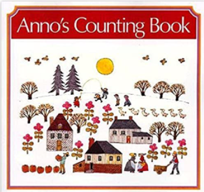
Maths : Numerical Patterns
Selection of linked objectives and ideas for supporting child development |  | Early Learning Goals | Useful Books
Enjoys reciting numbers from 0 to 10 (and beyond) and back from 10 to 0 • Increasingly confident at putting numerals in order 0 to 10 (ordinality) Uses number names and symbols when comparing numbers, showing interest in large numbers | Sing counting songs and count together forwards and backwards, sometimes starting from different numbers and in different step sizes. Discuss numbers coming | Verbally count beyond 20, recognising the pattern of the counting system
Matches the numeral with a group of items to show how many there are (up to 10) • In practical activities, adds one and subtracts one with numbers to 10 • Begins to explore and work out mathematical problems, using signs and strategies of their own choice, including (when appropriate) standard numerals, tallies and “+” or “-“ • Estimates of numbers of things, showing understanding of relative size | Begin to model calculations in mathematical stories and number rhymes and in real contexts, using a range of ways of representing (e.g. five-frames). Use both informal and standard ways to record these, including tallies and symbols. Discuss children’s own graphical strategies to solve problems, using some vocabulary of addition and subtraction. Encourage children to make predictions and visualise the outcome in stories, rhymes and songs if one (or two) is added or taken away. | Compare quantities up to 10 in different contexts, recognising when one quantity is greater than, less than or the same as the other quantity
 |  | Explore and represent patterns within numbers up to 10, including evens and odds, double facts and how quantities can be distributed equally

