Slide 1
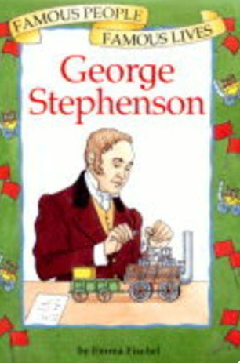
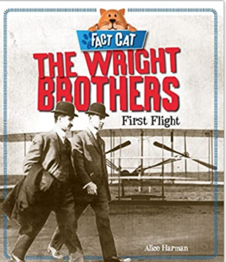
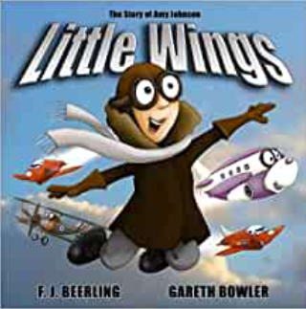
Great Inventions : Transport Knowledge Mat
Subject Specific Vocabulary |  | Interesting Books | Sticky Knowledge about Transport History
timeline | A tool which helps us organise information in chronological order | Important image to understand by the end of the Celebrations unit:
inventor | .A person who invents. Who has new ideas and makes something new which is helpful to others |  | One of the first trains was The Rocket, invented by Robert Stephenson in 1829. It was built and tested in the UK.
aviation | Flying using an aircraft
 | Also known as your backbone, your spine is a strong, flexible column of ring-like bones that runs from your skull to your pelvis. |  | The first motorised and controlled flight was in 1903 by two brothers, Orville and Wilbert Wright
cockpit | The area of the plane where the pilot sits. Inside the cockpit are all the controls for the aircraft
fuselage | The body of the aircraft | Important image to understand by the end of the Celebrations unit: | The very first flight lasted just 12 seconds.
locomotive | An engine that moves by its own power
engineer | A person who designs and builds buildings and structures. |  | Isambard Kingdom Brunel was an important engineer who designed the first railways. George Stephenson and his son, Robert designed The Rocket. This was the train which won the Rainhill Trials.
eyewitness account | An account of what happened from someone who was there at the time |  | The Rainhill Trials were a competition which was held to decide which mode of transport should be used on the Liverpool and Manchester Railway.
evidence | Photographs, objects, newspaper entries, diaries, telling us about what it was like in the past

