Slide 1
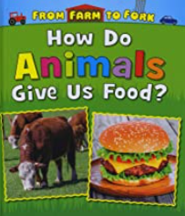
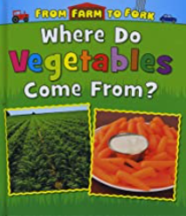
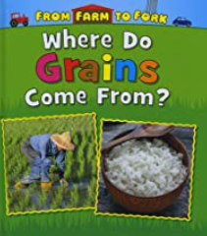
Food Journeys Knowledge Mat
Subject Specific Vocabulary |  | Interesting Books | Sticky Knowledge about local food production
fresh food | A food that has not been altered | Important image to understand by the end of the Celebrations unit:
processed food | A food or ingredient that has been altered in some way eg by freezing, canning, baking, mixing with other ingredients. This is performed in a factory. |  | Identify geographical similarities and differences between human and physical features in the local area
high street | The main street in a village, town or city which usually contains a mixture of shops
 | Also known as your backbone, your spine is a strong, flexible column of ring-like bones that runs from your skull to your pelvis. |  | use locational and directional language (e.g. near and far) to describe the location of features and routes on a map
warehouse | Food products are stored in a warehouse before being taken to shops
factory | Food produce can be processed in a factory by baking, canning, freezing or mixing with other ingredients | Important image to understand by the end of the Celebrations unit: | Know how everyday products are made eg milk and cereals and identify which products are fresh and which are processed or fast foods
land use map | A map which shows what is being grown in each field or what is being developed in each area
cereals | There are several different types of cereal, e.g. wheat, oats, barley, rice, maize and rye. They are grown in fields and are used to make bread, biscuits, breakfast cereals, cakes and other products |  | Identify the four countries and capital cities of the UK and recognise the different weather conditions which promote the production of different regional products eg Scottish oats
 |  |  | use world maps, atlases and globes to identify the UK and its countries, as well as the countries, continents and oceans studied at this key stage. Use this information to find hot and cold areas of the world and how this affects what can be grown
Food producers or farmers | People who produce our food. They may plant crops and/ or raise animals to do this. The food they sell is called produce.
compass | A device used to give us directions North, South, East and West

