Slide 1
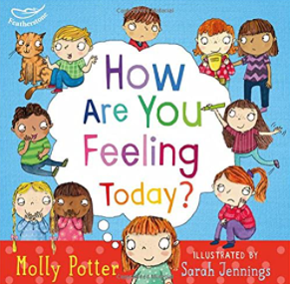
Personal, Social, Emotional Development : Self Regulation
Selection of linked objectives and ideas for supporting child development |  | Early Learning Goals | Useful Books
Shows their confidence and self-esteem through being outgoing towards people, taking risks and trying new things or new social situations and being able to express their needs and ask adults for help | Offer help with activities when asked but not before and see struggle and mistakes as important parts of learning. Provide experiences and activities that are challenging but achievable. | Show an understanding of their own feelings and those of others, and begin to regulate their behaviour accordingly
Can describe their competencies, what they can do well and are getting better at; describing themselves in positive but realistic terms | Plan regular opportunities for children to talk to their small group about something they are interested in or have done. | Give focused attention to what the teacher says, responding appropriately even when engaged in activity, and show an ability to follow instructions involving several ideas or actions
Shows confidence in choosing resources and perseverance in carrying out a chosen activity | Give time for children to pursue their play and learning without interruption, to complete activities such as role play, construction, building dens and painting to their satisfaction, and to return to their activities if they wish. | Set and work towards simple goals, being able to wait for what they want and control their immediate impulses when appropriate
Has a clear idea about what they want to do in their play and how they want to go about it • Shows confidence in choosing resources and perseverance in carrying out a chosen activity | Notice and appreciate young children’s efforts not just their achievements, encouraging their inner motivation rather than working just for your approval or a sticker.

