Slide 1
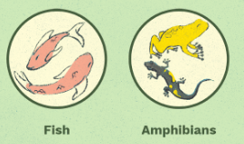
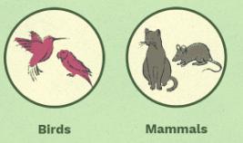
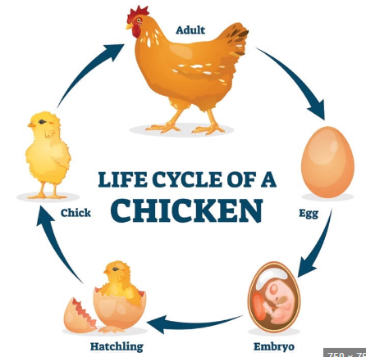
Common Plants and Animals Knowledge Mat
Subject Specific Vocabulary |  |  | Sticky Knowledge about Plants and Animals
Carnivore | A carnivore is an organism that eats mostly meat, or the flesh of animals. Sometimes carnivores are called predators
 |  |  | II can identify some spring flowering plants such as daffodil, snowdrop, bluebell, primrose, celandine
Herbivore | A herbivore only feeds on plants. It can be an animal, fish, insect, and even a predatory plant |  | Keeping healthy includes looking after our mental health. Doing things that we enjoy releases chemicals in our brains which make us happy.
 |  |  | I can identify some common fish,amphibians, birds and mammals which are local to our area
Omnivore | Omnivores are animals that eat both plants and other animals. |  | Our bodies need healthy food and drink to develop and grow. We need a balanced diet with enough energy, protein, calcium, fibre, vitamins and minerals to keep us well,
Lifecycle | A life cycle is a series of stages a living thing goes through during its life |  | I know that many plants flower in the spring and summer when there are pollinating insects around and the weather is warmer.
Amphibian | Amphibians are cold-blooded vertebrates (vertebrates have backbones) that don't have scales. They live part of their lives in water and part on land.
Amphibian | Amphibians are cold-blooded vertebrates (vertebrates have backbones) that don't have scales. They live part of their lives in water and part on land. |  | I know that the structures of birds, fish and mammals are different. I can identify gills, fins and scales on fish, I can explain how birds, fish and mammals are different.
Mammal | Mammals have either no legs, or four legs. Some have special front legs called arms. And feet called hands. Mammals are all warm blooded. Which means, whatever the temperature is outside, they keep the same body temperature inside.
 |  |  | I know that all animals including humans have a lifecycle. I can identify the lifecycle stages for a hen. Egg /embyo – chick – hen. I can compare this with the lifecycle of a humn
Gills | A gill is the body part that helps a fish breathe underwater. In fish and other aquatic creatures, their gills are equivalent to our lungs. Fish and some amphibians need to breathe the oxygen in water to live, and they use their gills for this
 |  |  | I know animals can be herbivores, carnivores or omnivores. I can give an example of each based on the animals which are common to our local area.
Fins | A fin is the part of a fish's body that sticks into the water and helps it balance and move in various directions. Sharks use their dorsal fins to stabilize their bodies as they propel through the water.

